Slide 1
Forecasting Interest Rates
Structural Models

Slide 2
Structural Models
Structural models are an attempt to determine causal relationships between various economic variables:
  Exogenous variables: Taken as given
  Endogenous Variables: Explained by the model
Exogenous
Model
Endogenous

Slide 3
Example: Demand
Demand:
    Exogenous: Income (I), Price (P)
    Endogenous: Quantity Demanded (D)
Exogenous
Income
Price
Endogenous
Quantity Demanded
Model
D = D( I, P)

Slide 4

Example: Demand
The basic model suggests that as prices fall, quantity demanded rises
  For a given level of income and preferences, if P=$12, Q = 300.
  If price falls to $8 (again, for a fixed level of income and preferences), Q =400

Slide 5
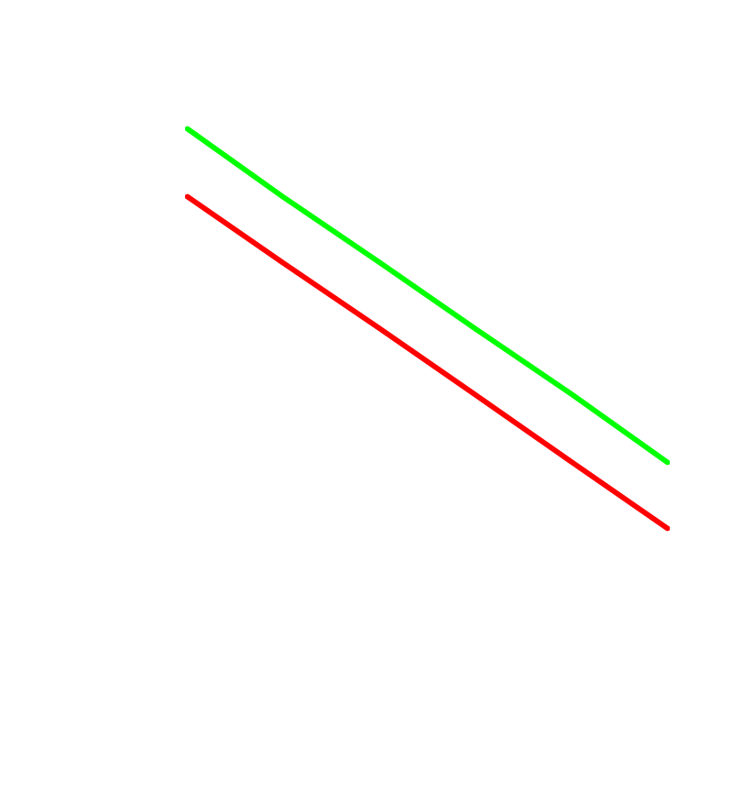
Example: Demand
As income increases, demand increases.
  For a given level of income and preferences, if P=$12, Q = 300.
  If Income rises, Q=400 at a price of $12

Slide 6
Example: Supply
Supply:
  Exogenous: Costs (C), Price (P)
  Endogenous: Quantity Supplied (S)
  S = S(C, P)

Slide 7

Example: Supply
The basic model suggests that as prices rise, quantity supplied increases

Slide 8

Example: Supply
As costs rise, supply falls
Qs = S(C,P)

Slide 9

Equilibrium
Qd = D(I,P)
Qs = S(C,P)
In Equilibrium, Qs = Qd
P* = P(I,C)
Q* = Q(I,C)
  Note that Price is no longer exogenous, it is explained!

Slide 10
Using Models to Forecast
In the previous example, we ended up with a price equation
    P = P(C,I)
The next step would be to estimate the model
    P = a(C) + b(I) (where a and b are constants)
Now, note that the following implies:
    P’ = a(C’) + b(I’) (‘ indicates a future value)
Therefore, to forecast Price:
  Forecast Costs (C’)
  Forecast Income (I’)
  Insert into the estimated price equation to get P’

Slide 11
Interest Rate Models
(Real Interest Rates)
Economic models look at how optimizing behavior by households and firms translates into the supply and demand for credit.
  Firms choose capital investment projects to maximize shareholder value (Demand)
  Households choose consumption/savings to maximize utility (Supply)
  Supply = Demand defines the equilibrium interest rate

Slide 12
Household Savings
Without an active financial markets, household consumption is restricted to equal current income
With capital markets, the present value of lifetime consumption must equal the present value of lifetime income (assuming all debts are eventually repaid)

Slide 13
A Simple Example
Suppose that your current income is equal to $50,000 and you anticipate next year’s income to be $60,000. The current interest rate is 5%.
In the absence of financial markets, your consumption stream would be $50,000 this year and $60,000 next year.
C = Y (Current Consumption = Current Income)
C’ = Y’ (Future Consumption = Future Income)

Slide 14

Consumption Possibilities

Slide 15
Now, Add Financial Markets
You can alter your current consumption by taking out a loan or putting money in the bank
C = $50,000 + (Borrowing/Lending)
Loans must be repaid with interest next year. Deposits earn interest (for simplicity assume that these rates are the same)
C’= $60,000 – (1.05)(Borrowing/Lending)
Y (Current Income)
Y’ (Future Income)

Slide 16
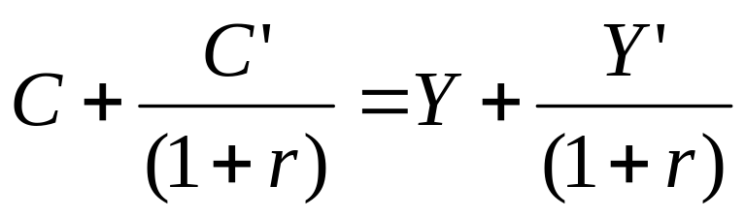
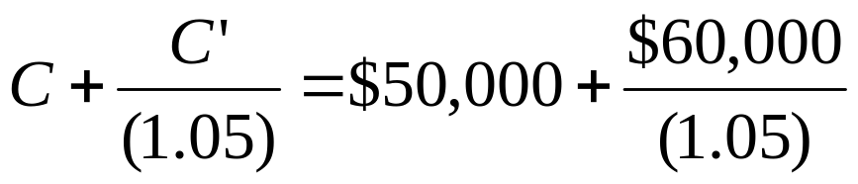
Now, Add Financial Markets
We can combine these two conditions to get the following:
In the previous example, we had

Slide 17

Consumption Possibilities
Lending
Borrowing
The budget constraint indicates all the possible ways to consume your lifetime wealth (PV of lifetime income)

Slide 18

Consumption Possibilities
$112,500
$107,142
Slope = $112,500/$107,142 = 1.05 = (1+ r)
This is the relative price of future consumption in terms of current consumption

Slide 19
Optimal Behavior
Households need a way to “Rank” consumption/savings choices. This is done with a Utility Function
U(C, C’) = Total Utility
Utility functions only have two restrictions
  More of everything always better (total utility is increasing in consumption)
  The more you have, the less its worth (As consumption increases, marginal utility decreases)

Slide 20
Optimal Behavior
Given the possibilities, households choose an optimal solution
Marginal Benefit = Marginal Cost
Increase in Happiness From Spending an Extra $ Today
(Marginal Utility)
Decrease in Happiness From Spending an Extra $ Tomorrow
(Marginal Utility)
=
(1+r)

Slide 21

Optimal Consumption
Savings = $20,000
Suppose that at an interest rate of 5%, you choose to save $20,000. Note that tomorrow’s consumption is now $60,000 + $20,000(1.05) = $81,000

Slide 22

Savings

Slide 23
Optimal Behavior
We know this decision is optimal. Therefore, we can say that:
Marginal Utility
At C = $30,000
Marginal Utility
At C’ = $81,000
=
(1.05)

Slide 24
Optimal Behavior
Suppose that interest rates increase to 7%.
Marginal Utility
At C = $30,000
Marginal Utility
At C’ = $81,000
<
(1.07)
We need to alter consumption a bit to re-balance this equation!! (We need to raise today’s marginal utility and lower tomorrow’s!!)
This can be done by raising future consumption and lowering current consumption.

Slide 25
Optimal Consumption
Savings = $30,000
Suppose that at an interest rate of 7%, you choose to save $30,000. Note that tomorrow’s consumption is now $60,000 + $30,000(1.07) = $92,100

Slide 26
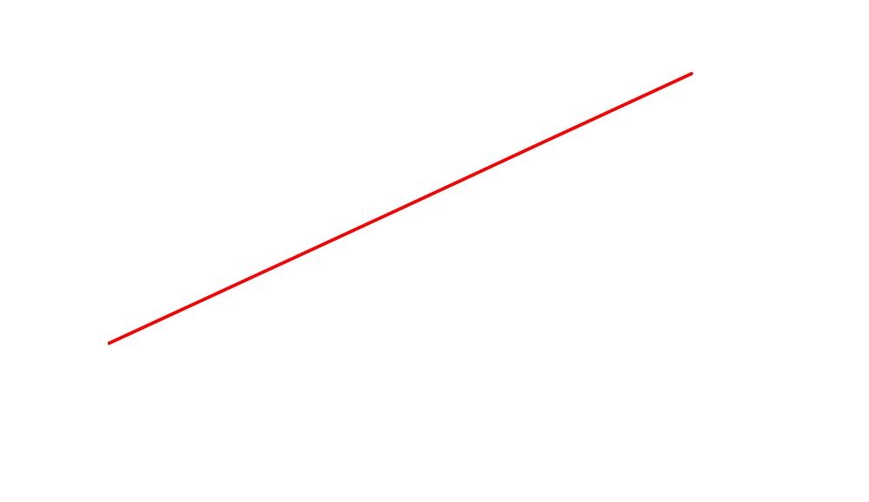
Aggregate Savings
S

Slide 27
Optimal Behavior
Suppose you alter your consumption to C = $20,000 (S = $30,000) , C’ = $92,000
Marginal Utility
At C = $20,000
Marginal Utility
At C’ = $92,100
=
(1.07)
The new consumption pattern is also optimal!!

Slide 28
Again, assume that the interest rate is 5%, consider two individuals
Person A
Current income: $10,000
Anticipated future income: $50,000
Wealth: $57,619
Person B
Current Income: $50,000
Anticipated Future income: $8,000
Wealth: $57,619

Slide 29
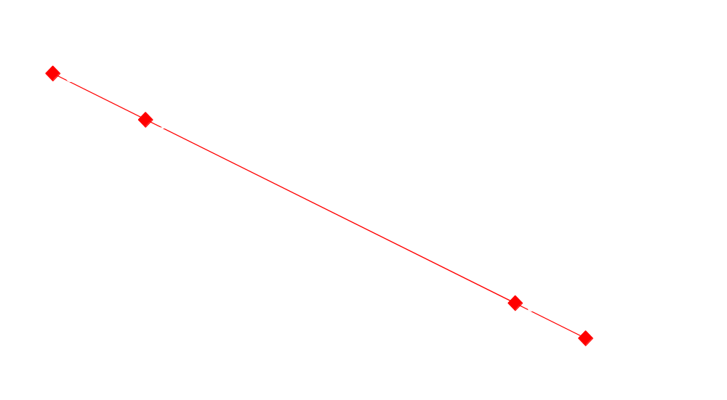
Consumption and Wealth

Slide 30
Consumption and Wealth
With capital markets, consumption is not determined by current income, but by wealth (present value of lifetime income)
These two individuals, having the same wealth, should choose the same consumption

Slide 31
Again, assume that the interest rate is 5%, consider two individuals
Person A
Current income: $10,000
Anticipated future income: $50,000
Wealth: $57,619
Current Spending: $30,000
Savings: -$20,000
Person B
Current Income: $50,000
Anticipated Future income: $8,000
Wealth: $57,619
Current Spending: $30,000
Savings: $20,000

Slide 32
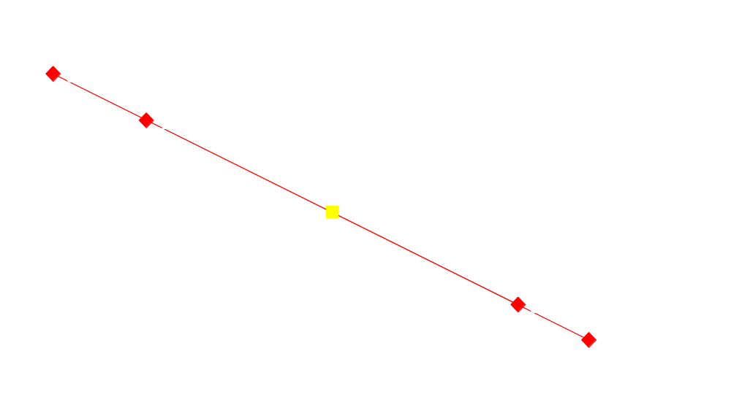
Consumption and Wealth
S = -$20,000
(Person A)
S = $20,000
(Person B)

Slide 33
Consumption and Wealth
With capital markets, consumption is not determined by current income, but by wealth (present value of lifetime income)
These two individuals, having the same wealth, should choose the same consumption.
For a given level of wealth, savings declines with income growth

Slide 34
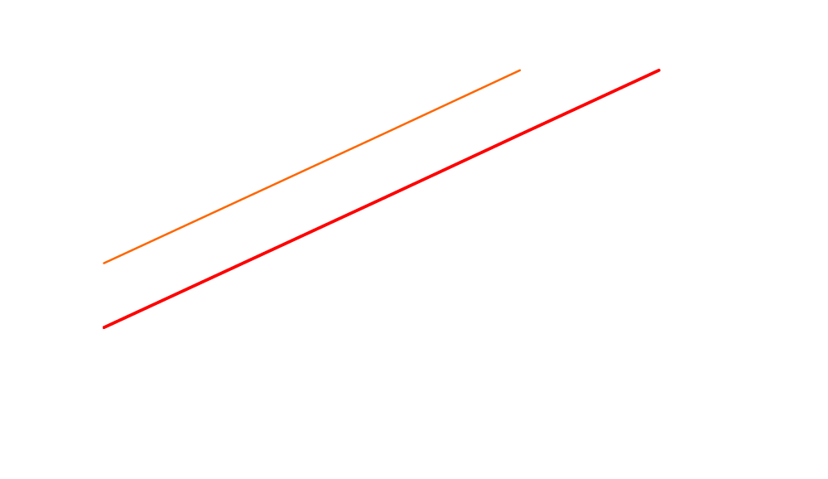
Aggregate Savings
S’
S
From the previous example, a rise in income growth might reduce savings from 20 to 10.

Slide 35
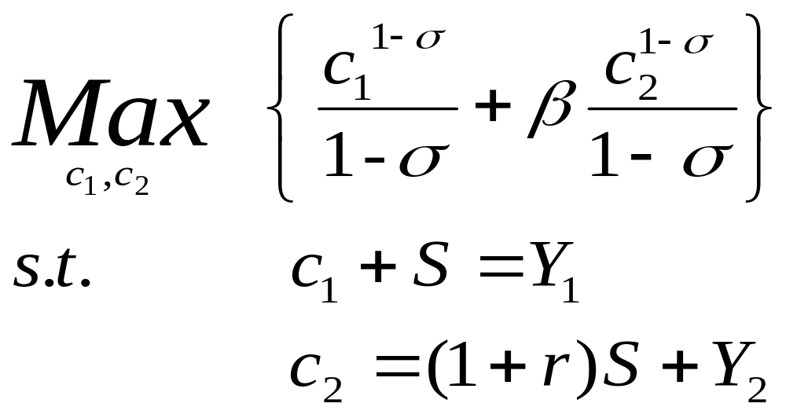
A Quantitative Example

Slide 36
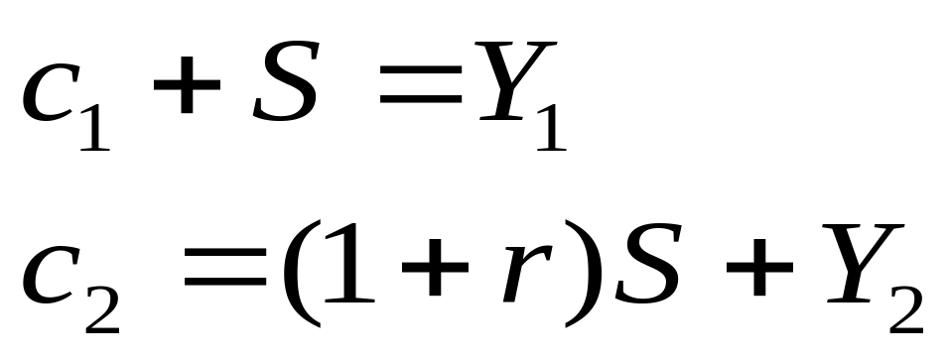
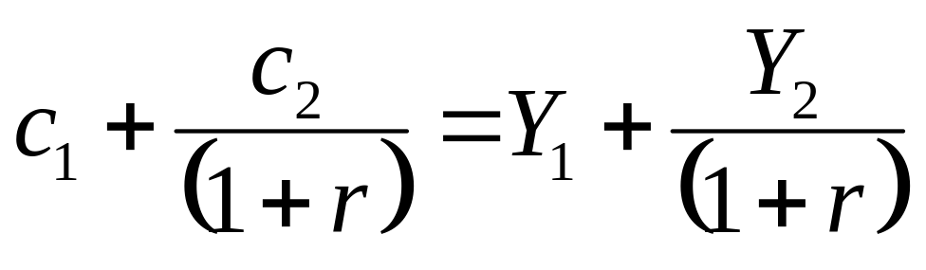
Step #1: Affordability
Recall that the two constraints can be reduced to one constraint by eliminating ‘S’

Slide 37
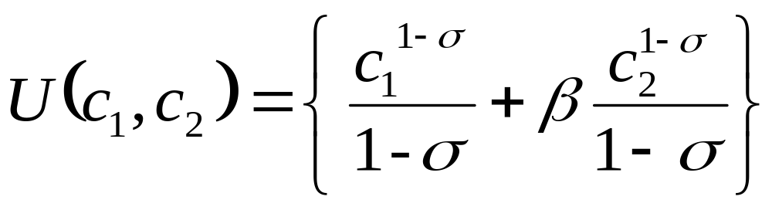
Step #2: Optimality
Increase in Happiness From Spending an Extra $ Today
(Marginal Utility)
Decrease in Happiness From Spending an Extra $ Tomorrow
(Marginal Utility)
=
(1+r)

Slide 38
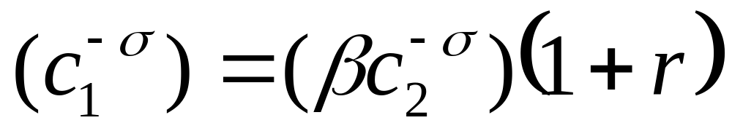
Step #2: Optimality
Marginal Utilities are just the derivatives!!
Marginal Utility Today
Marginal Utility Tomorrow

Slide 39
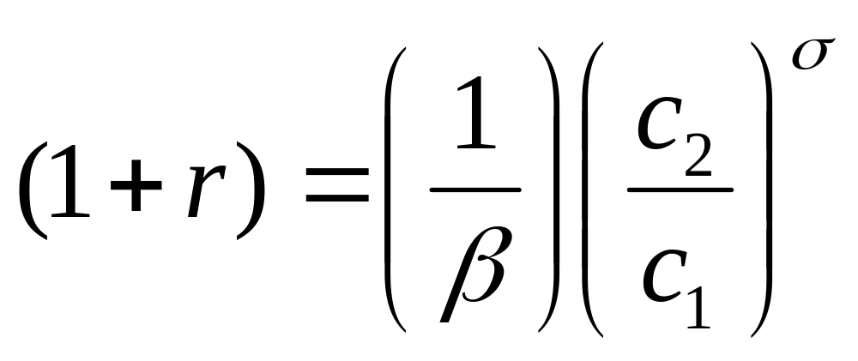
Characterizing the Solution
Note that the interest rate is independent of the absolute level of consumption. (The interest rate is stationary)
The long run mean is determined (primarily) by beta
The Variance is determined by sigma
Current and Future consumption can be found by inserting the above restriction into the wealth constraint

Slide 40
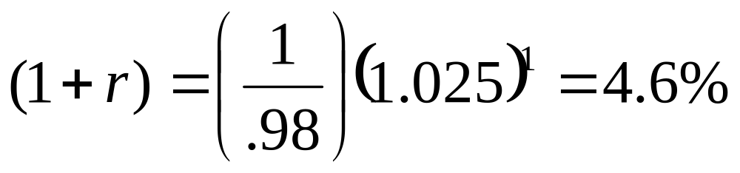
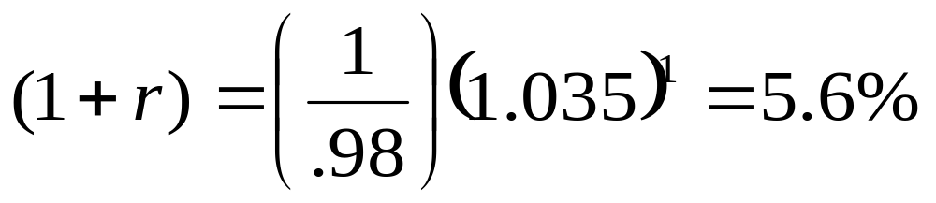
US Interest Rates
In the US, real consumption growth averages 2.5% per year
Beta is assumed to equal .98, sigma equals 1
Suppose that US consumption growth increases to 3.5%........

Slide 41
Capital Investment
Investment refers to the purchase of new capital equipment by the private sector
Firms only invest in projects that add to shareholder value. Therefore, they invest in positive net present value projects.
Present Value of Lifetime Profits > Cost

Slide 42
A Numerical Example
Consider an investment project that generates $25/year in profits. It has an initial cost of $100. The current interest rate is 5%. Is this project worthwhile?
...
Present
Value
$25
$25
$25
=
$25
+
+
+
+
(1.05)
(1.05)
2
(1.05)
3
Year 0
Year 1
Year 2
Year 3
Present
Value
$25
=
=
$500
>
$100
.05
Cost

Slide 43
A Numerical Example
An alternative way of asking the same question is: Does this project generate a sufficient internal rate of return given the firm’s cost of capital (5%)?
Annual $ Return
Internal Rate of Return
$25
.25
=
=
>
.05
$100
Investment Cost
Given the 5% market interest rate, any project that generates an internal rate of return of at least 5% is profitable

Slide 44
Defining Production
A production function defines total output for given supplies of the factors of production (Capital, Labor and Productivity)
  Y = F(K, L, A)
Output
Capital
Productivity
Labor
Production should exhibit diminishing marginal returns. That is, as capital increases (holding other factors fixed), its contribution to production decreases

Slide 45
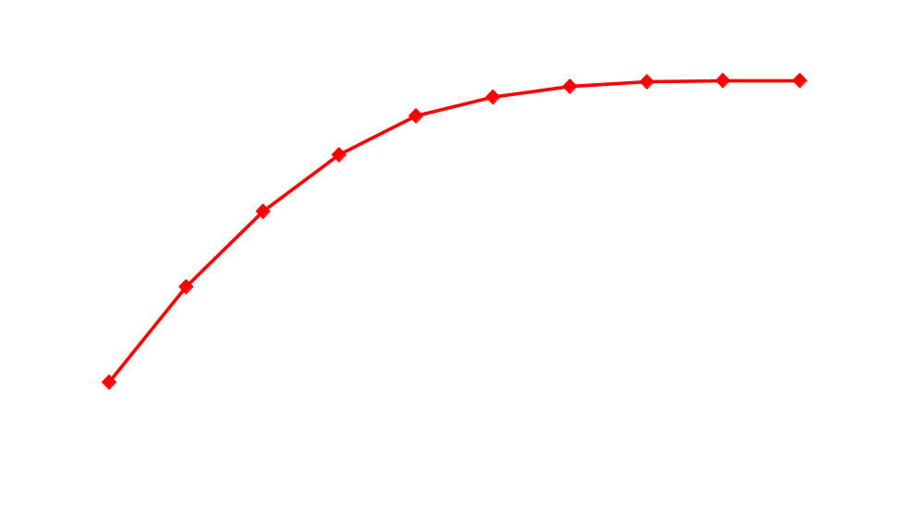
Production (Holding Employment Fixed)
F(K,L,A)
Internal Rate of Return = 10%
$10
$100
Internal Rate of Return = 25%
$25
$100

Slide 46
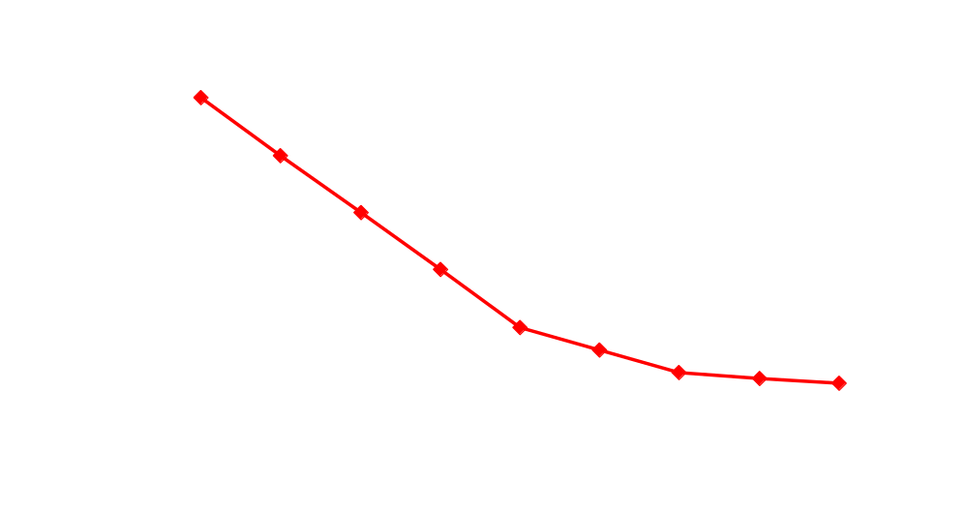
Internal Rates of Return
Given the market interest rate of 5%, the first 5 investment projects are profitable.

Slide 47
Investment Demand
It is assumed that labor and capital are compliments. That is, when employment rises, the productivity of capital increases as well.
Therefore, as a rise in employment should increase the demand for capital and, hence, the demand for loans
Further, any technological improvement should also raise the demand for investment

Slide 48
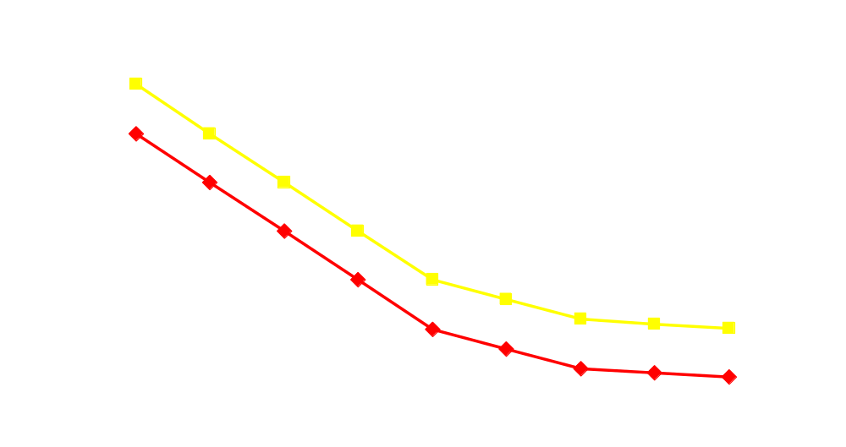
A Rise in Investment Demand
At a market interest rate of 10%, a productivity improvement might increase investment demand from $400 to %500

Slide 49
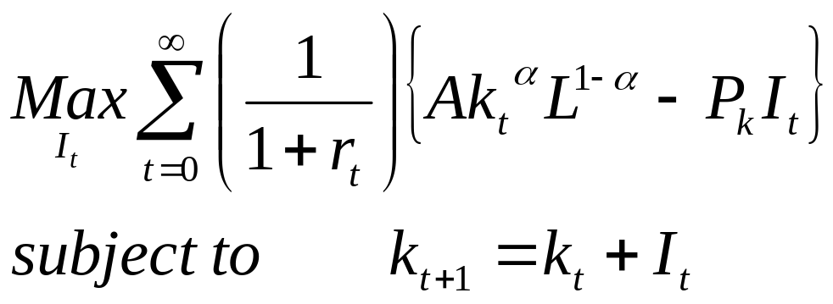
A Numerical Example
This is the Production Function
This is the Cost of Investment
New investment increases the capital stock
To get the internal rate of return, take the derivative of production with respect to ‘K’ and divide by the price of capital.

Slide 50
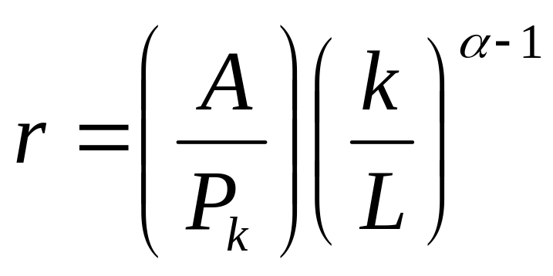
Characterizing the Solution
From the Demand side, we see that the interest rate is influenced by:
  Productivity (A)
  Price of Capital (P)
  Relative Factor Supplies (K, L)

Slide 51

Capital Market Equilibrium
A capital market equilibrium is an interest rate that clears the market (i.e.,savings equals investment)
  r*= 10%,
  S* = I*= 300
S
I

Slide 52
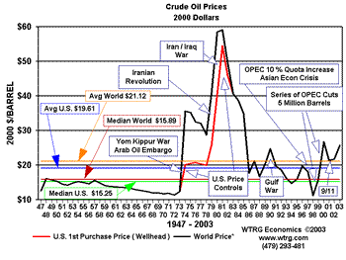
Example: Oil Price Shocks
Two oil price shocks occurred in the 1970’s. The first (1973) was widely considered permanent while the second (1979) was considered more temporary

Slide 53
First Oil Price Shock
A rise in energy prices permanently lowers incomes
S
I
With both current and future consumption falling, savings does not change

Slide 54

First Oil Price Shock
A rise in energy prices permanently lowers productivity
S
I
A drop in productivity lowers investment demand
Interest rates should fall

Slide 55

Second Oil Price Shock
A temporary rise in oil prices temporarily lowers income and consumption (c1 falls)
S
I
To “buffer” some of the loss in income, savings drops

Slide 56
Second Oil Price Shock
A temporary drop in productivity has a negligible impact on capital investment projects
S
I
Investment remains unchanged
Interest rates rise

Slide 57
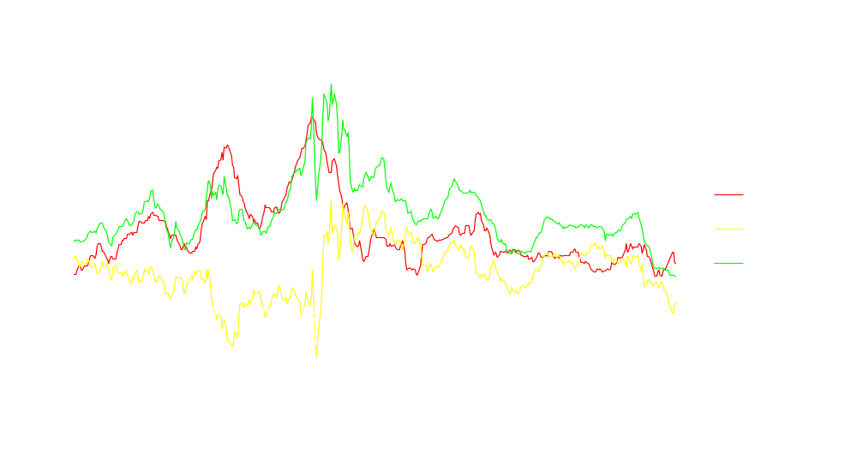
Example: Oil Price Shocks
Real interest rates fell in (1973), but increased in 1979.

Slide 58
Government Deficits and Interest Rates
Last year, the government borrowed roughly $450 billion from financial markets. Should this have an impact on real interest rates?

Slide 59
Nominal Interest Rates & Inflation
i = r + Inflation?
  Wealth effects (Higher inflation lowers the purchasing power of lifetime wealth)
  The Darby effect (The government taxes nominal income)
  Expected vs. Actual inflation

Slide 60
Nominal Interest Rates & the Fed
The Federal Reserve has two potentially offsetting effects on the nominal interest rate:
    Liquidity Effect
    Anticipated Inflation effect

Slide 61
Forecasting Nominal Interest Rate
Any Interest rate equation could potentially have any of the following variables:
  Income Growth
  Proxies for productivity
  Relative price of capital
  Government Deficits
  Inflation Rates
  Monetary Policy Variables

Slide 62
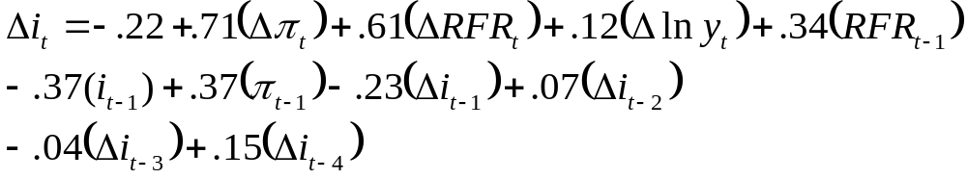
Mehra Model
If you are currently in time ‘t’ and would like to make a forecast of TBill rates in time ‘t+1’. What would you need?

Slide 63
Mehra Model
To Forecast the TBill rate, you need:
  A Forecast for price (to calculate the inflation rate)
  A Forecast of Federal Reserve Policy
  A Forecast of GDP (to calculate income growth)
  Past history of TBill Rates and Inflation

